Slide 1
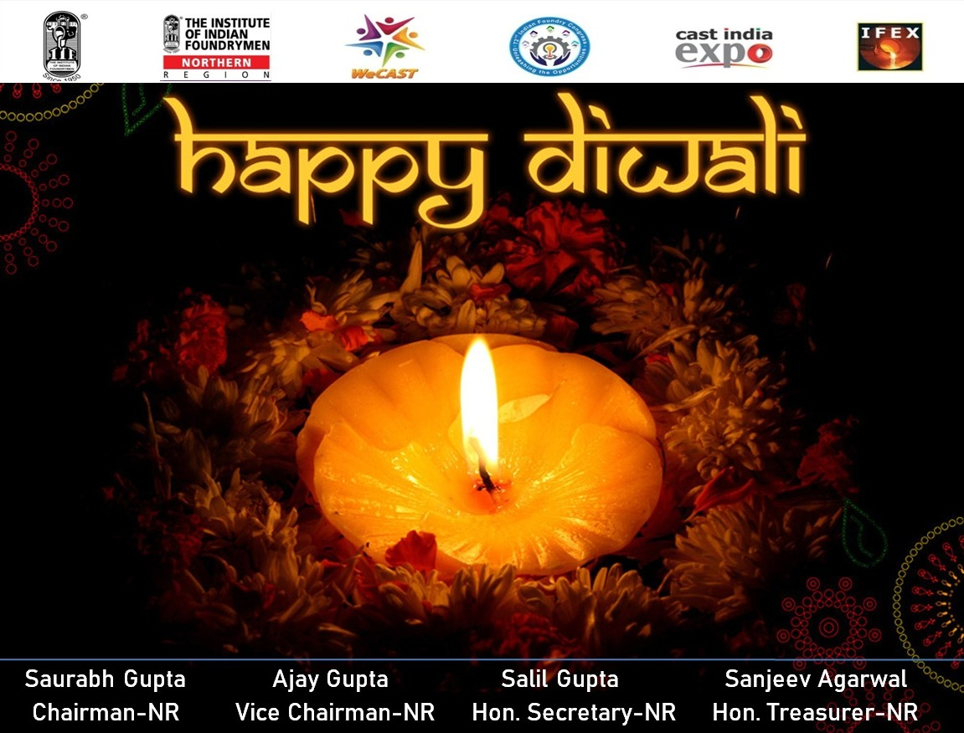

Annual Activity Report
IIF Northern Region 2023-24

Slide 2
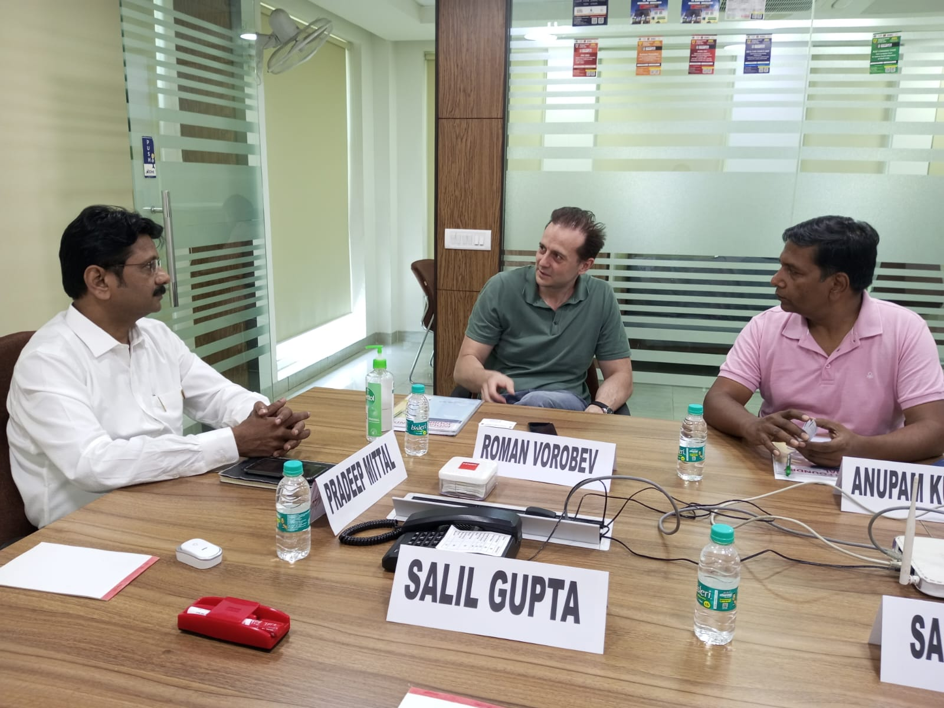
April-2023
1. FIC under its International Connect Cell and IIF NR hosted the Russian delegation at IIF New Delhi office on 13.04.2023
The Russian delegation was led by Mr. Roman Vorobev, OMK Steel, Russia and his team. Mr. Roman is also an ex- diplomat actively working in Indian sub-continent

Slide 3
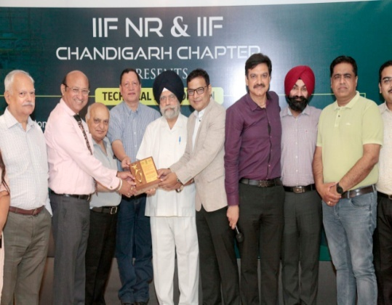
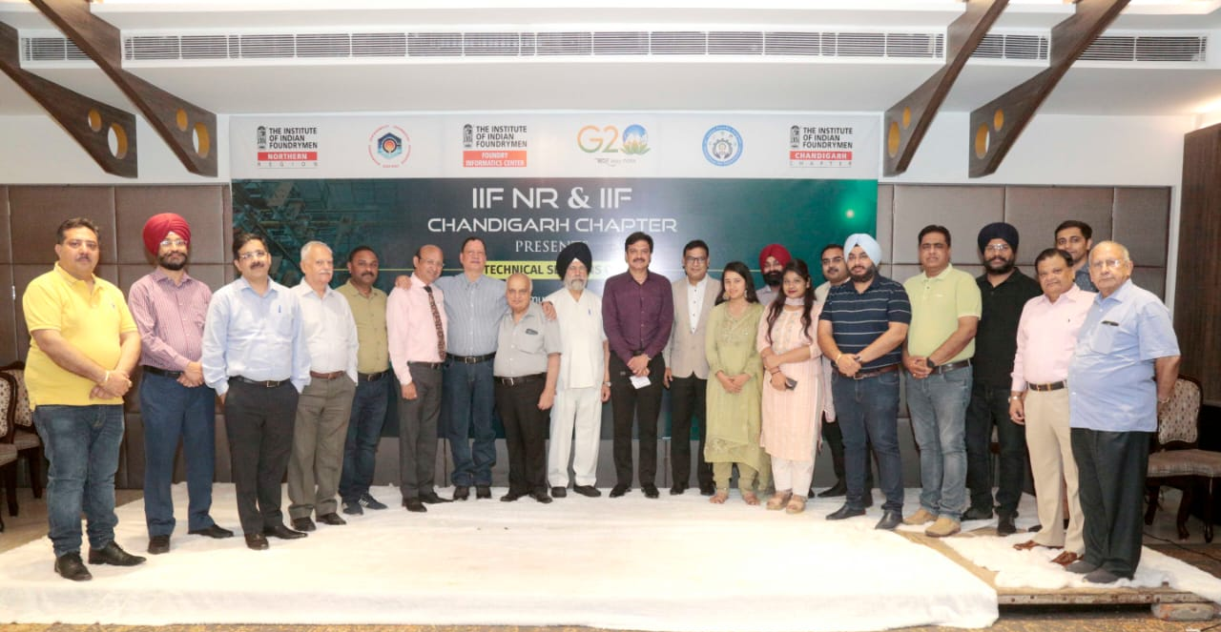
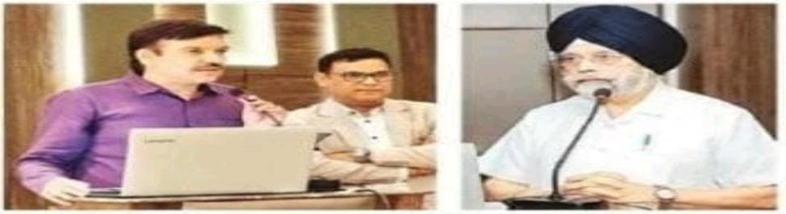
May - 2023
2. IIF NR and IIF Chandigarh Chapter conducted an awareness program on Low cost Automation, how to reduce casting defects and SIDBI Schemes for MSMEs on 26th May 2023 at Jalandhar.

Slide 4
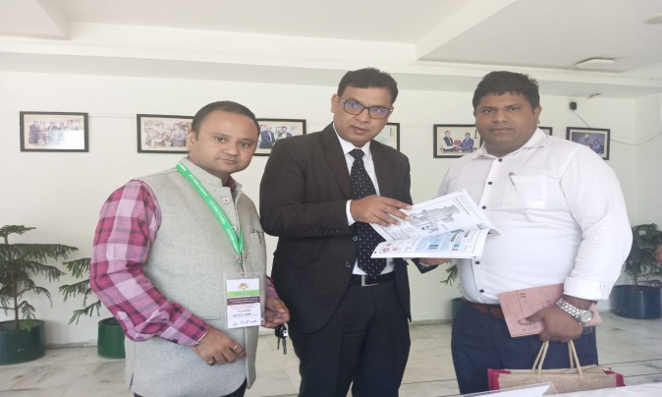
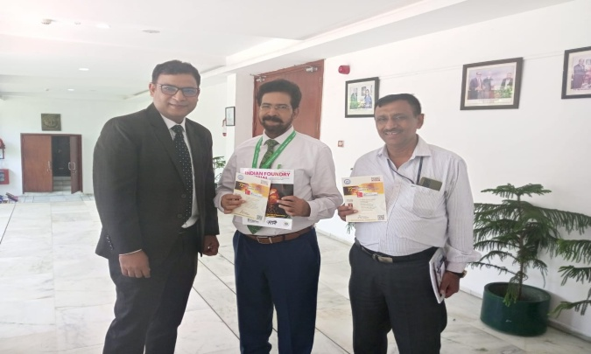
June-2023
3. IIF under its International Connect Cell through FIC joined the Indo-Scandinavian Leadership Conference & Workshop on the topic "New World Order" held on 6th June 2023 organized by, NTPC, NOIDA.

Slide 5
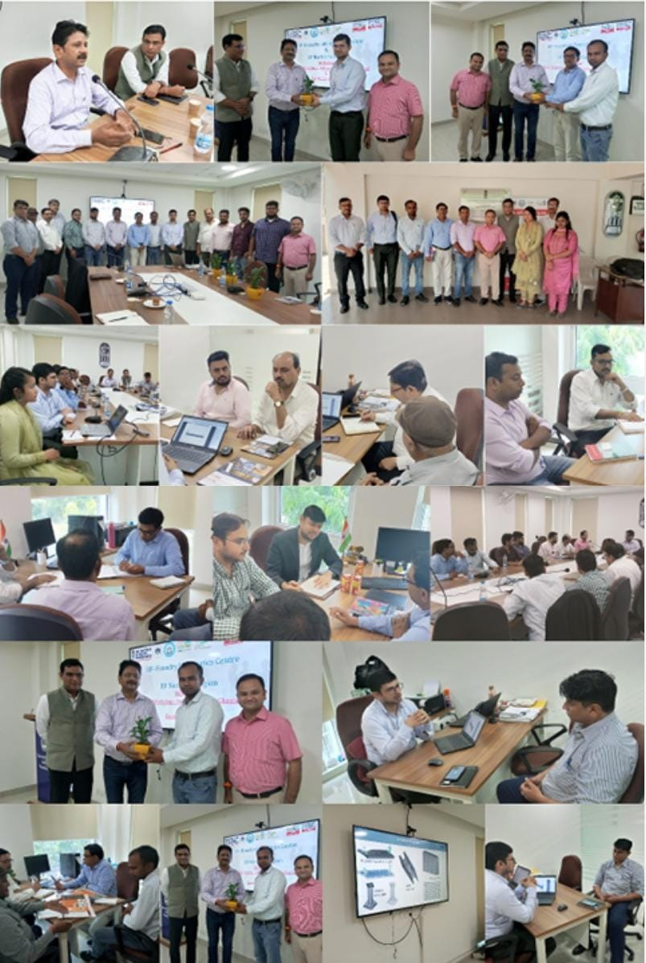
July-2023
4. IIF NR & FIC organized B2B meetings on 19th July 2023 at IIF New Delhi office.
Buyers Present:
- Signal Workshop, Indian Railways, Ghaziabad
- Danieli Corus Limited.
Sellers: 15

Slide 6
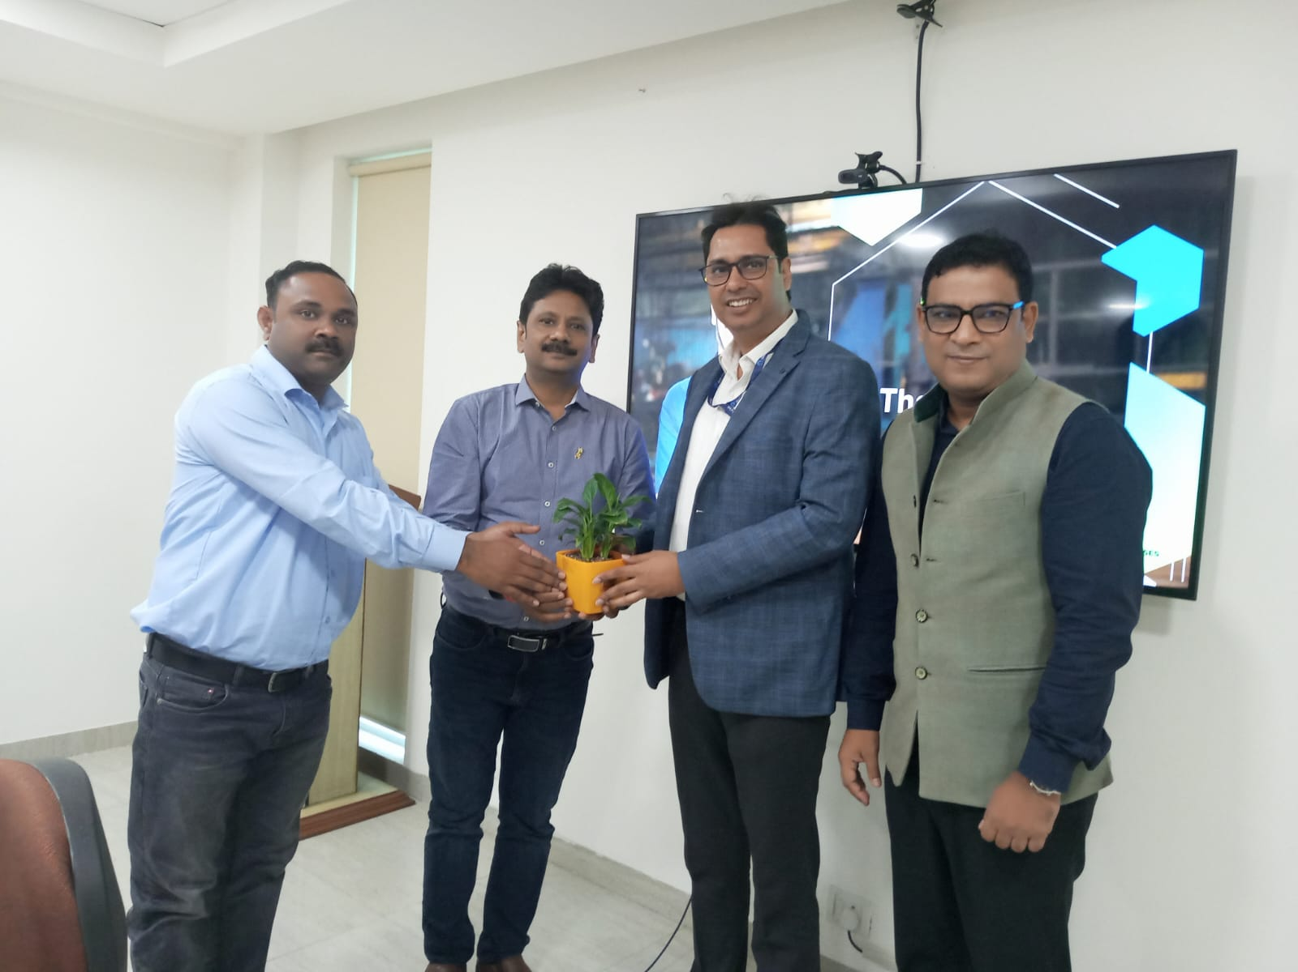
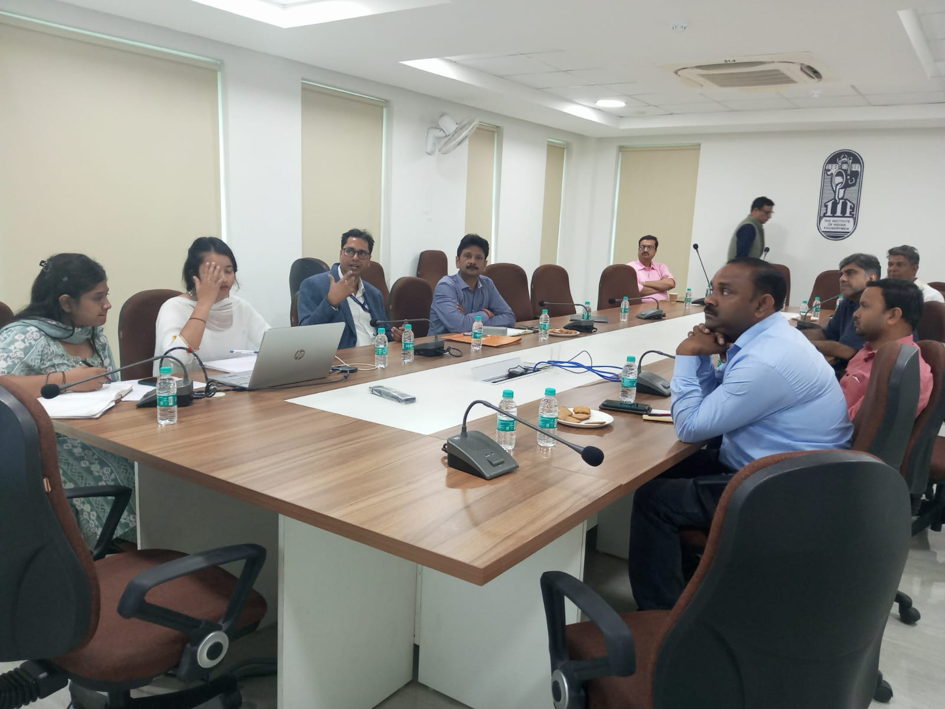
July-2023
5. Seminar on “MSME ZED Certification and its benefits for the Foundry Industry" , 24th July 2023 at IIF New Delhi. Dr. Ramanand Shukla, Director & Head, ZED – Quality Council of India (QCI) was the Key Speaker.

Slide 7
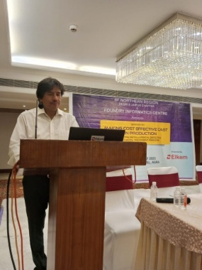
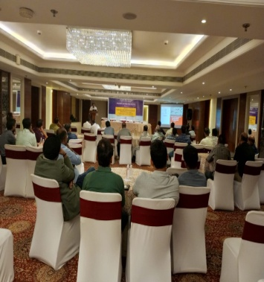
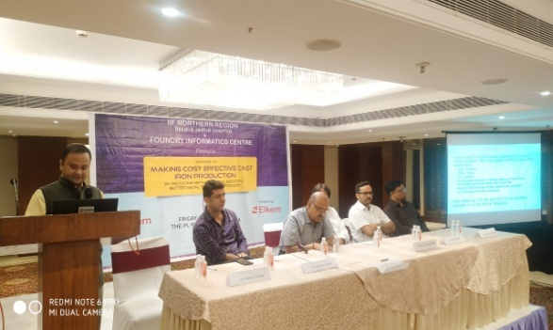
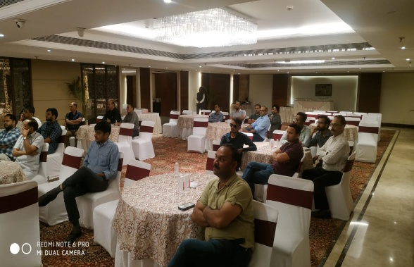
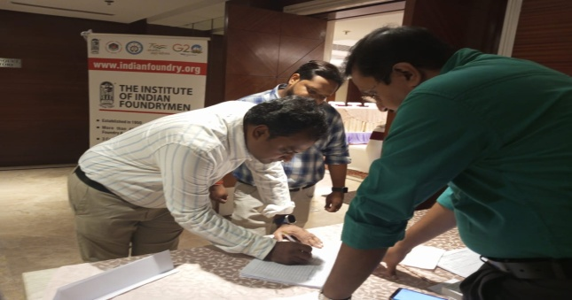
July-2023
6. IIF NR and FIC jointly organized a seminar on “Making Cost Effective Cast Iron Production by reducing metallurgical Defects & Better Metal Treatment Process” on 28th July 2023 at The PL Palace Hotel, Agra. The seminar was powered by “Elkem”

Slide 8
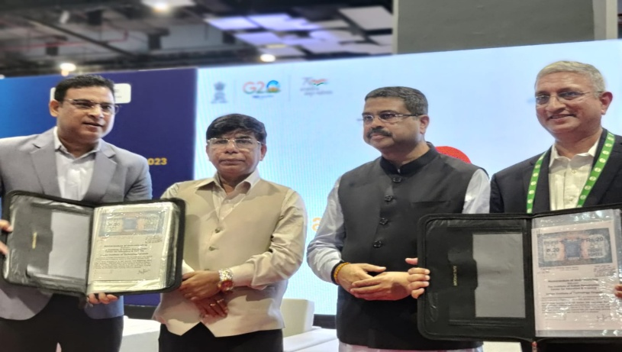
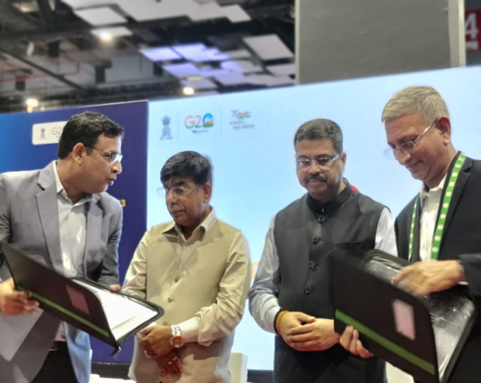
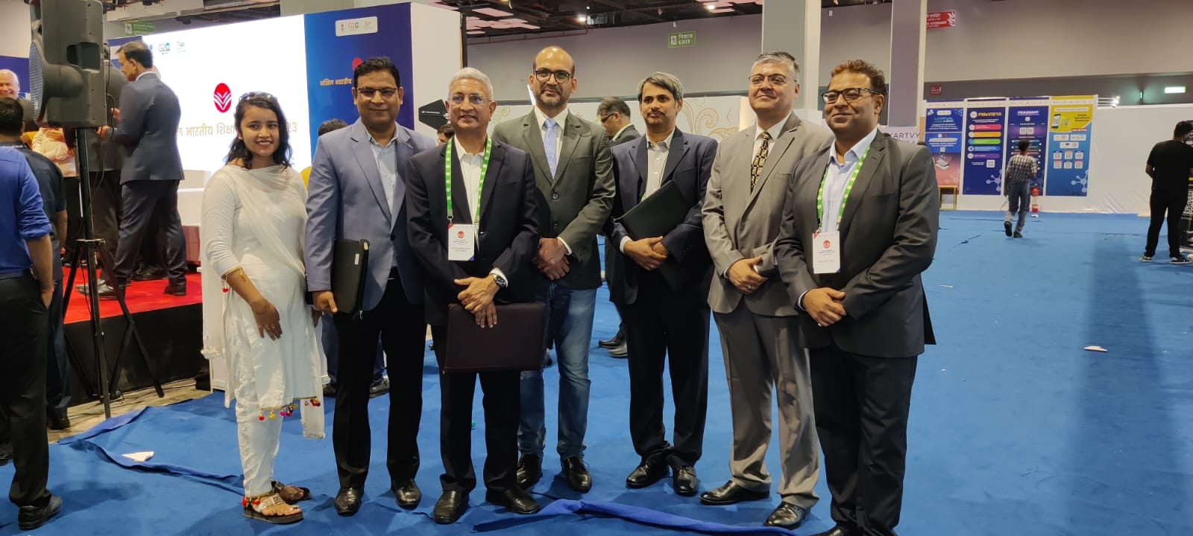
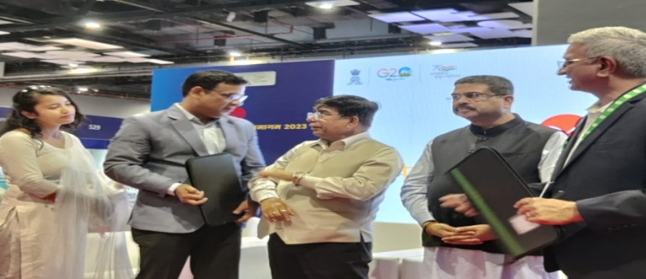
July-2023
7. MoU Exchange between CET, IIF and IIT Tirupati at Bharat Mandapam, New Delhi in presence of Shri Dharmendra Pradhan, Hon'ble Minister of Education and Min of Skill Development and Entrepreneurship, GoI, and
Dr Subhash Sarkar, MoS, Education, GoI.

Slide 9
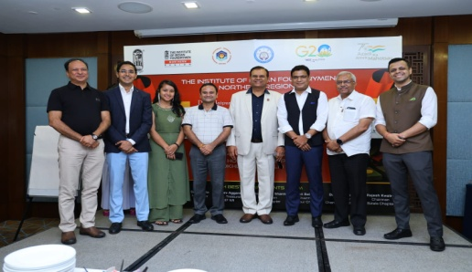
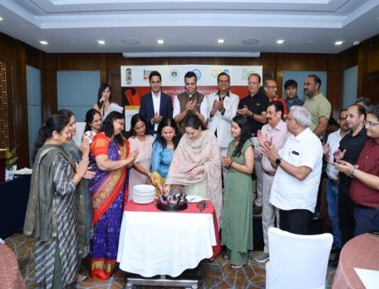
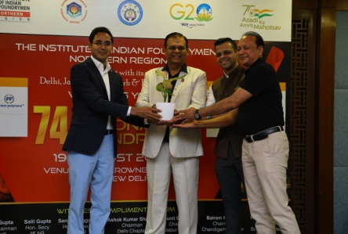
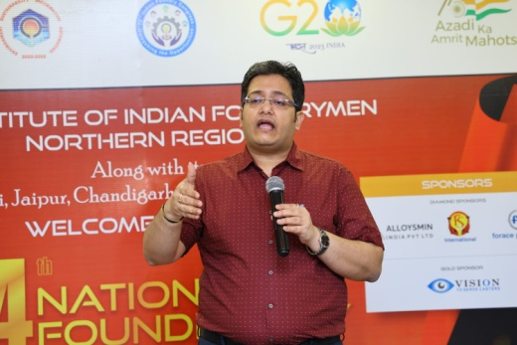
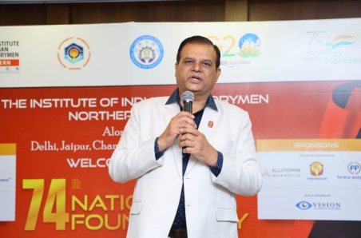
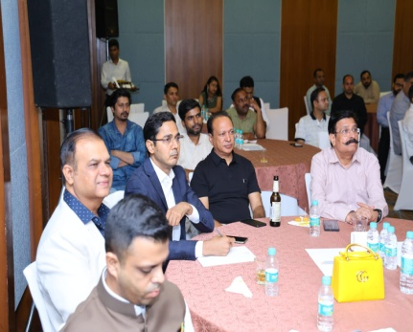
August-2023
8. IIF Northern Region along with its Delhi, Batala, Chandigarh &Jaipur chapters celebrated the 74thNational Foundry Day (NFD) on 19th August 2023 at Hotel Crown Plaza, Okhla, New Delhi.

Slide 10
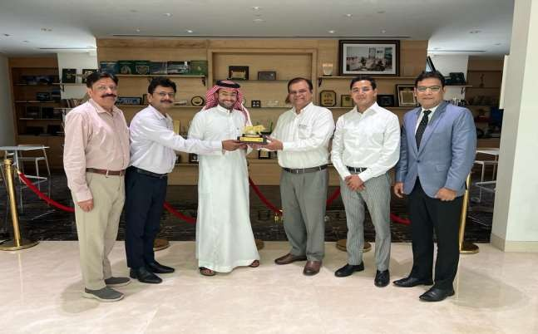
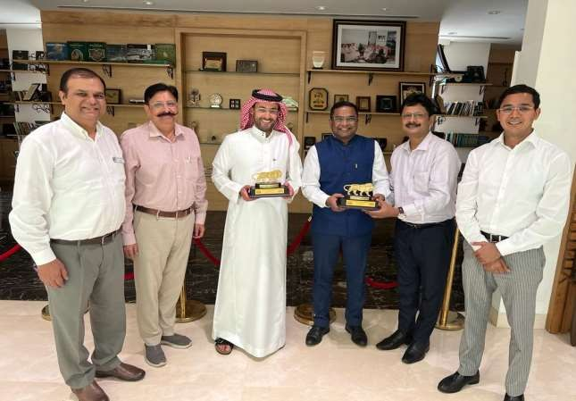
September-2023
9. Interaction with Mr. Saleh S Alabdulrahman, Commercial Attaché & Head of Commercial Section & Mr. Alok Priya Azad, Investment Advisor, Saudi Commercial Attaché Office, Royal Embassy of Saudi Arabia, New Delhi & IIF through IIF NR and FIC, September 20, 2023, at Royal Embassy of Saudi Arabia, New Delhi.

Slide 11
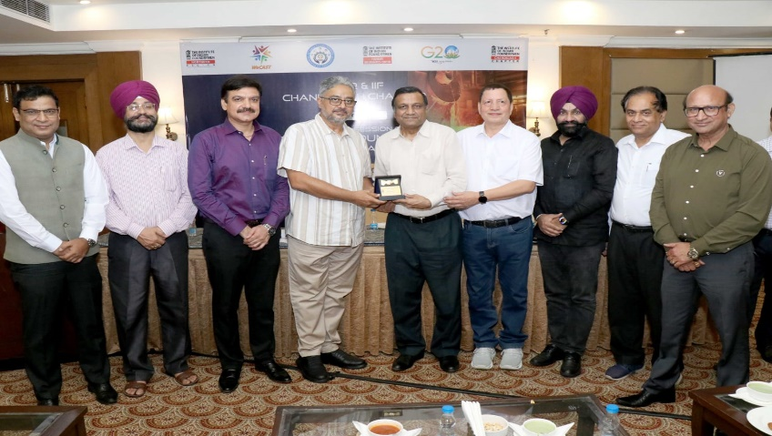
September2023
10. NR and FIC jointly organized a seminar on Modern Trends In Foundry -Simulation & 3d Scanning on September 22, 2023 at Hotel Ramada, Jalandhar. The key speaker was Mr. Raman Gupta, Managing Director – Kadkraft Systems Pvt. Ltd, Mohali

Slide 12
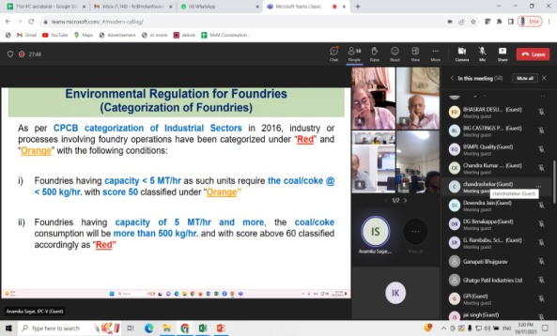
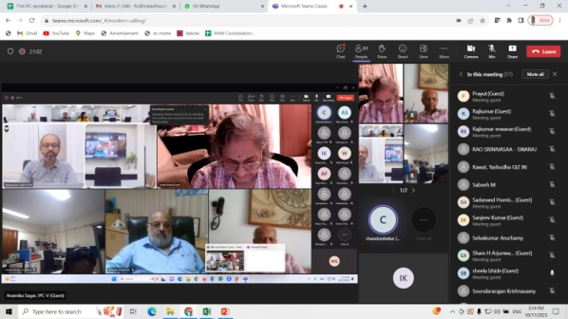
October-2023
11. The Institute of Indian Foundrymen (IIF) jointly with GIZ organized a webinar on Best Available Techniques (BATs) for the Indian Foundry Sector: Enhancing Resource Efficiency and Green Technologies on 17th Oct 2023.

Slide 13
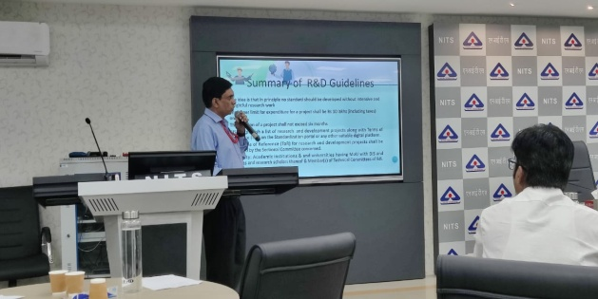
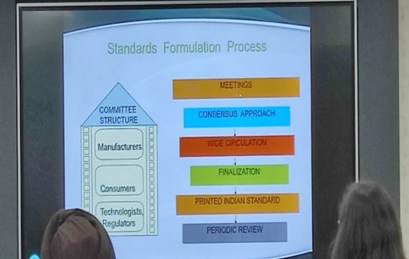
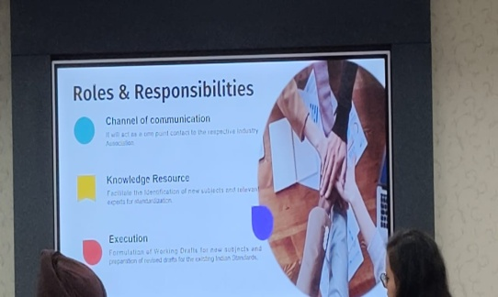
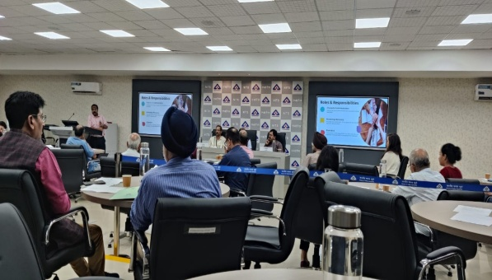
October-2023
12. Participated in Bureau of Indian Standards, Govt. of India Reinforcement Training For Standardization Cells of Industry Associations.

Slide 14
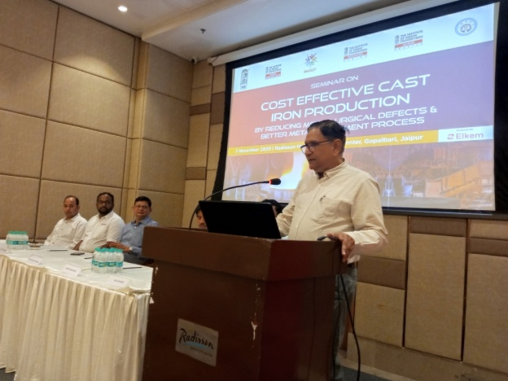
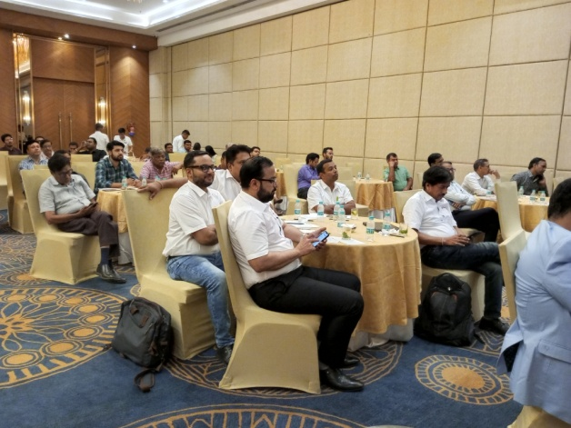
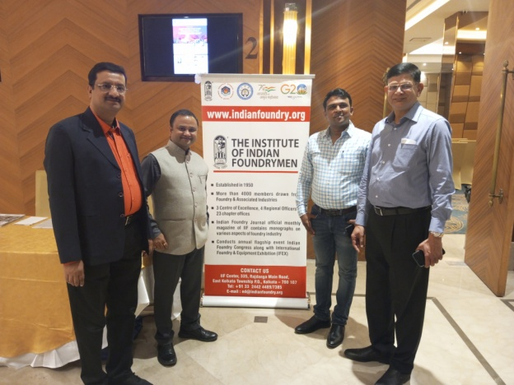
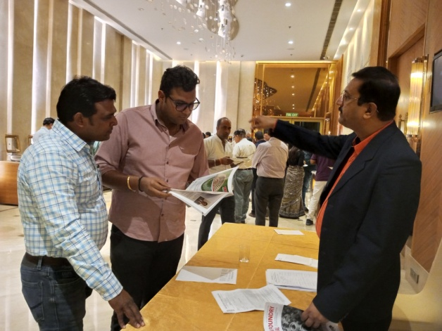
November-2023
13. IIF Northern Region, IIF Jaipur Chapter and FIC jointly organized a seminar on “Making Cost Effective Cast Iron Production by reducing metallurgical Defects & Better Metal Treatment Process” on 3rd November 2023 at The Radisson Hotel, Jaipur.

Slide 15
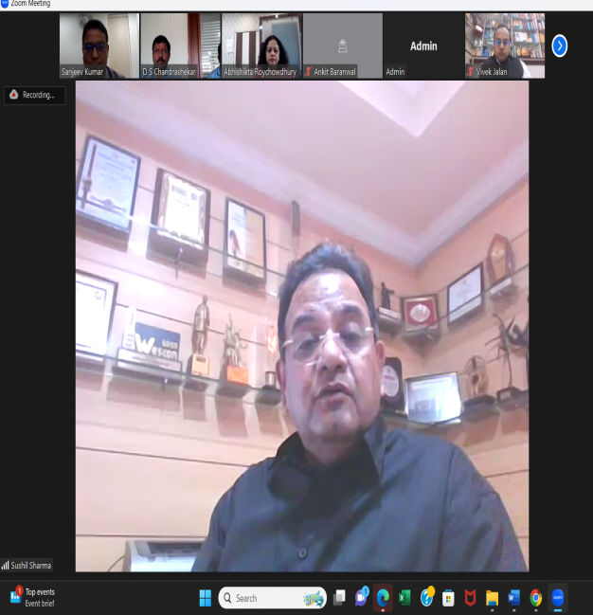
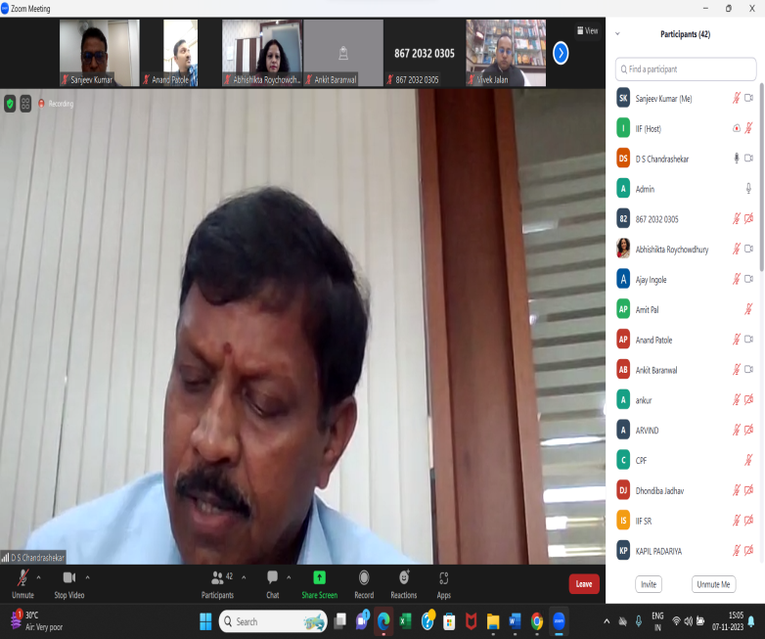
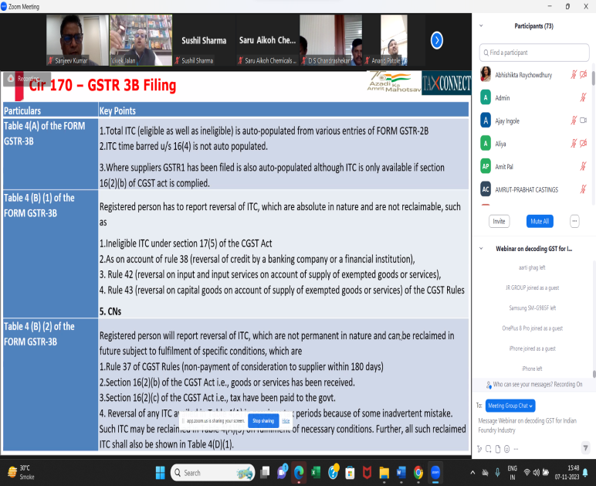
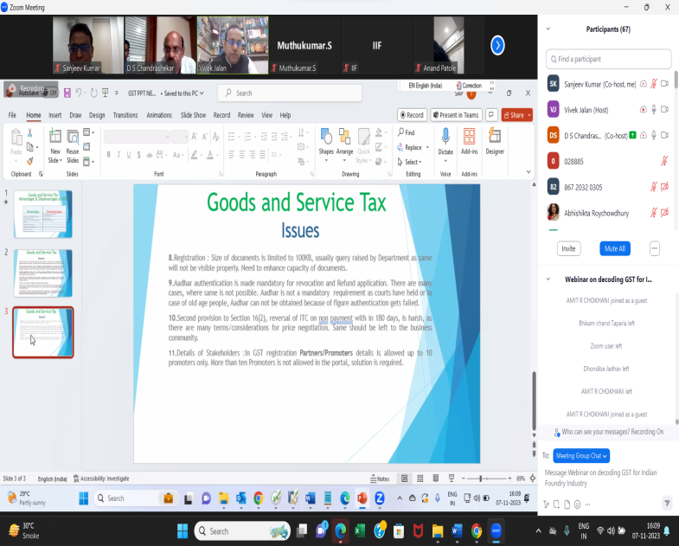
November-2023
14. Webinar on the topic “Decoding GST for Indian Foundry Industry” on 7th November 2023.,The webinar was aimed at having an interactive session for IIF members with the key speakers talking on ease of doing it and also present industries perspective

Slide 16
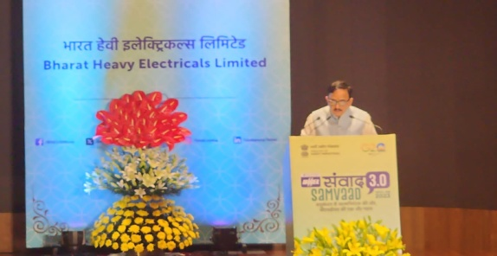
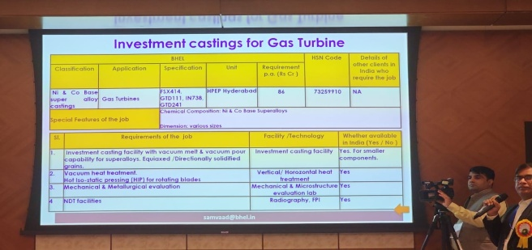
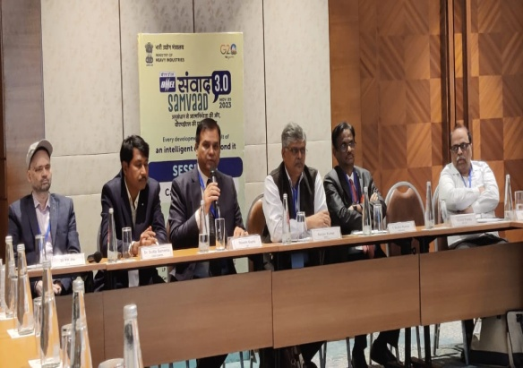
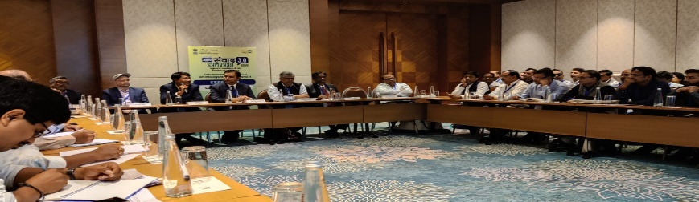
November-2023
15. Participation at BHEL Samvaad 3.0 organized by BHEL at Bharat Mandapam New Delhi, 9thNovember 2023, Dr. Mahendra Nath Pandey, Hon. Minister, Ministry of Heavy Industries, Govt. of India addressed the gathering as Chief Guest.

Slide 17
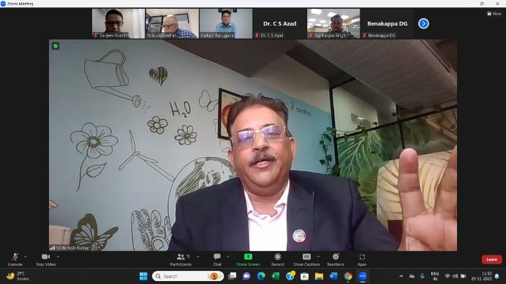
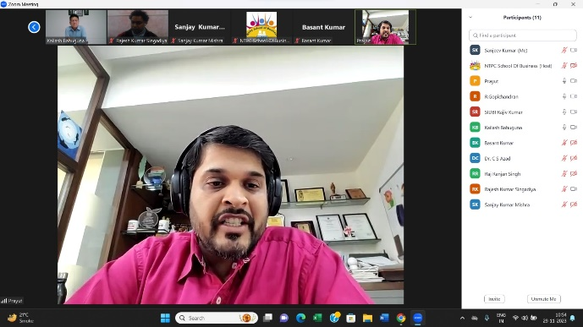
November-2023
16. NSB- IIF-SIDBI 2-Day Online Management Development Program on "Integrated Energy Efficiency and Emission Reduction Gains through Preventive Environmental Management ", 28-29 November 2023 (On Virtual Platform)

Slide 18
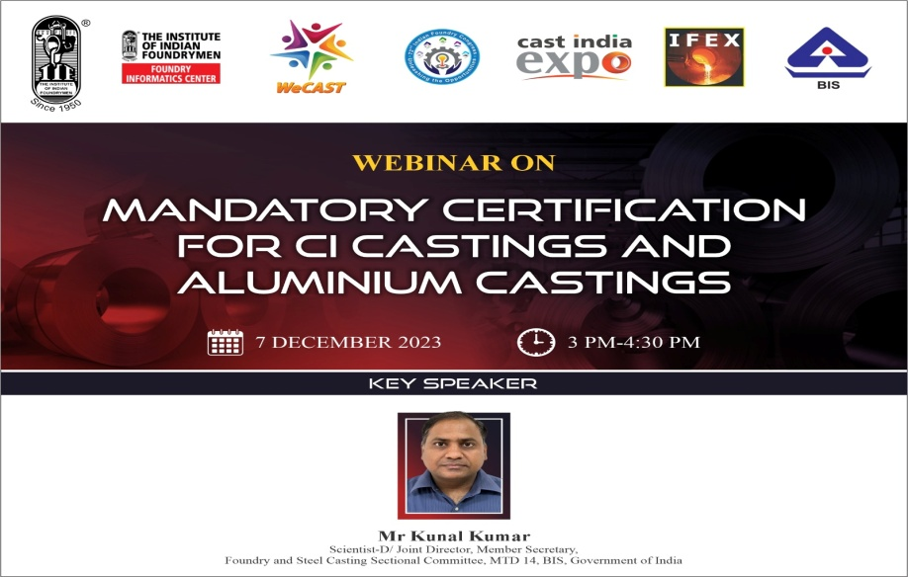
December-2023
17.FIC & IIF-NR in partnership with Bureau of Indian Standards, Govt of India organized a webinar on the topic “Mandatory Certification for CI Castings and Aluminium Castings” on 7th of December 2023.

Slide 19
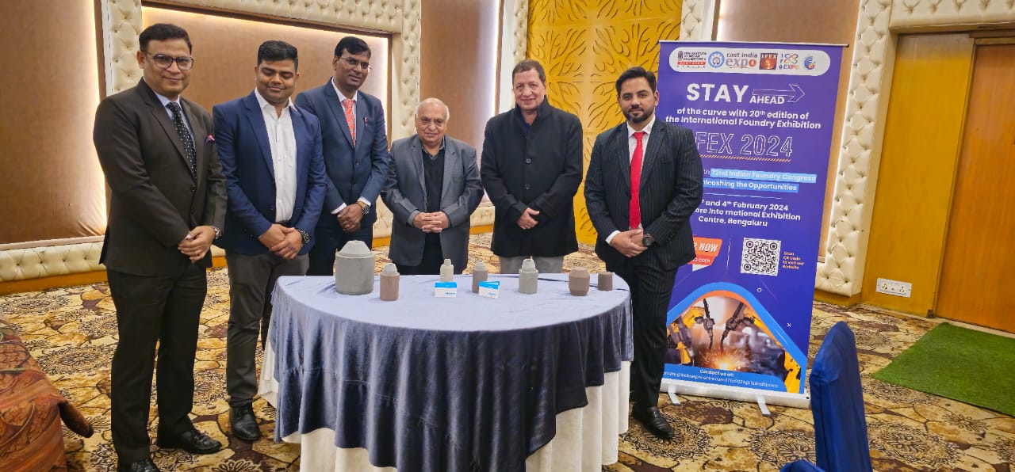


December-2023
18. Chandigarh Chapter of The Institute of Indian Foundrymen conducted a technical awareness program on Modern Casting Feeding Solutions on Arun Sood, Chairman Kumar Autocast Ltd. Ludhiana was the Chief Guest

Slide 20

January -2024
The National Office Bearers along with Executive Director of IIF visited the FIC-IIF Delhi office on 10th January 2024.
Chairman, FIC, Chairman, IIF Standard Advisory Committee, Chairman, IIF Northern Region, Hon. Treasurer, IIF NR and Chairman, IIF Delhi Chapter along with the Secretariat were present

Slide 21


Inauguration of Foundry Galleria Foundry Informatics Centre, IIF New Delhi Office, Delhi
The Foundry Galleria was inaugurated by Mr D S Chandrashekar, President, The Instituter of Indian Foundrymen on 10 January 2024 at IIF-FIC Delhi Office.
The Foundry Gallery has Castings manufactured by Indian Foundries, information on status of foundry industry in India and also evolutionary story of the foundries. Productions, Export – Import Status and the current business trends are on display in the galleria.

Slide 22
FEBRUARY-APRIL 2024
BIS Licensing of IIF Members:
Conduct series of sensitization programme for its members on the QCO issued by DPIIT mandating BIS certification for Cast Iron Products and the licensing processes. BIS has joined hands with IIF and actively supporting the seminars.
A brief:
IIF- BIS Seminar at Jaipur:
IIF NR and IIF Jaipur Chapter under the leadership of Chairman, SAC organized a seminar on BIS licensing process on 15th February.
No. of Participants: Approx. 60+ ( Members & Non-members from Foundries only)
Key Speaker: Director and Head, BIS Jaipur Branch Office

Slide 23
2. IIF- BIS Seminar at Agra:
IIF NR and IIF Delhi Chapter organized a seminar on BIS licensing process on 22nd February 2024 at Agra.
No. of Participants: Approx. 75+ ( Members & Non-members from Foundries only)
Key Speaker: Jt. Director, BIS NOIDA Branch Office
3. IIF- BIS Seminar at Kolkata:
IIF NR and IIF ER under the leadership of Chairman, SAC organized a seminar on BIS licensing process on 1st March.
No. of Participants: Approx. 125+ ( Members & Non-members from Foundries only)
Key Speaker: Deputy Director, BIS Kolkata Branch Office

Slide 24
4. IIF- BIS Seminar at Faridabad:
IIF NR and IIF Delhi Chapter jointly with BIS organized a seminar on BIS licensing process on 15th March 2024 at Faridabad.
No. of Participants: Approx. 70+ ( Members & Non-members from Foundries only)
Key Speaker: Jt. Director, BIS Faridabad Branch Office
5. IIF- BIS Seminar at Ghaziabad:
IIF NR and IIF Delhi Chapter jointly with BIS under the leadership of Chairman, SAC organized a seminar on BIS licensing process on 18th March 2024.
No. of Participants: Approx. 75+ ( Members & Non-members from Foundries only)
Key Speaker: Deputy Director, BIS Ghaziabad Branch Office

Slide 25
6. IIF- BIS Seminar at Rajkot:
IIF NR and IIF Rajkot Chapter under the leadership of SAC organized a seminar on BIS licensing process on 23rd March 2024 at Rajkot.
No. of Participants: Approx. 50+ ( Members & Non-members from Foundries only)
Key Speaker: Director & Head, BIS Rajkot Branch Office
7. IIF- BIS Seminar at Nagpur:
IIF SAC and IIF Nagpur Chapter jointly with BIS organized a seminar on BIS licensing process on 8th April 2024 at Nagpur.
No. of Participants: Approx. 50+ ( Members & Non-members from Foundries only)
Key Speaker: Head, BIS Nagpur Branch Office

Slide 26
8. IIF- BIS Seminar at Coimbatore:
Date : 23 February 2024
No. of Participants: Approx. 70
Key Speaker: Head, BIS Coimbatore Branch Office
Upcoming Seminars:
- Kanpur - Ludhiana
- Ajmer - Baroda
- Kolkata - Pune
- Chennai - Indore
-Kolhapur - Batala………..
38 New Members Added with the help of the seminar series in FY 23-24 in NR

Slide 27






Snapshots
Jaipur | Agra | Coimbatore
Kolkata | Ghaziabad | Faridabad

Slide 28






Snapshots
Rajkot | Nagpur | Jalandhar
More images…

Slide 29


April -2024
. CAST SOURCE MEET
IIF-Northern region & Foundry Informatics Centre (FIC), one of the Centre of Excellence of The Institute of Indian Foundrymen organized a Cast Source Meet on a virtual platform Zoom on 15th April 2024.

Slide 30

MEDICAL HEALTH CHECK UP AND BLOOD DONATION
1st May 2024 at Jalandhar
IIF Chandigarh Chapter in partnership with Confederation of Indian Industries
(CII), Zonal Office, Jalandhar and Punjab Institute of Medical Sciences (PIMS)
organized a Medical Health Check up and Blood Donation Camp on 1st May 2024
at JMP Industries, Jalandhar.

Slide 31

May -2024
WEBINAR ON “Transforming of Foundries and Government of India Programs”
The Northern Region of the Institute of Indian Foundrymen organized a webinar on “Transforming of Foundries and Government of India Programs”, 10th May 2024 at 4:00 PM.
The Webinar was well attended by 75 participants from the Industry.

Slide 32



May -2024
SEMINAR ON “How to register and get your castings BIS certified”,Kanpur
IIF Northern Region and IIF Delhi jointly organized a seminar on “How to register and get your castings BIS certified ” on 24th May 2024 at Hotel Royal cliff, Kanpur . Total 89 participants including IIF Northern region chairman Mr. Salil Gupta, FIC Chairman, Mr. Pradeep Mittal, BIS Committee Chair, Mr. Dinesh Gupta, Northern region Council Member, Mr. Dev Duggal and senior members from Kanpur participated in the seminar.

Slide 33


May -2024
WEBINAR ON “GREEN FOUNDRY:CBAM AND OTHER COMPLIENCES
Foundry Informatics Centre and IIF Northern region Organized a webinar on “Green Foundry :CBAM and other Compliances” on 31st May 2024 on Virtual Zoom Platform.
Mr. Dinesh Gupta, welcomed all the participants and congratulated IIF-Northern Region & Foundry Informatics Centre for organizing webinar on the topic of interest and importance to the industries. He then welcomed the key note speaker Mr. Harsh Chowdhary ,Co-founder &CEO of Sentra World. And Mr. Vikas Upadhayay, COD and Co-founder of Centra world.

Slide 34



June -2024
Invitation from NIDM, Ministry of Home Affairs, GoI to Co-chair a High Level Session in “Young Leader’s Conclave on Environment and Disasters”, 04-05 June 2024 at NIDM Rohini Campus, Delhi.
Mr. Dinesh Gupta, Chairman, IIF Standard Advisory Committee speaking as Chairman of the Thematic Session on ‘Chemical Safety and Emergency management (including Waste Management)’ during “Young Leader’s Conclave on Environment and Disasters” organized by National Institute of Disaster Management (NIDM), Ministry of Home Affairs, Government of India in collaboration with the ICARS – IITR, IIT Roorkee, IIT Indore, GIZ India, ICARS, Roorkee, Wetland International, Youth4Water, Sphere India, Youth for resilience held on 4-5 June 2024 at New Delhi.

Slide 35


June -2024
WEBINAR ON “MSME COMPETITIVE (LEAN) SCHEME ”
The Northern Region of the Institute of Indian Foundrymen organized a webinar on “MSME COMPETITIVE (LEAN) SCHEME ” 19th June 2024 at 4:00 PM.
The Webinar was well attended by 85 participants from the Industry

Slide 36


June -2024
B2B Meeting organized by IIF Northern Region & Foundry Informatics Centre
IIF-Northern Region (NR) & Foundry Informatics Centre (FIC) organized B2B meetings on 28th June 2024 at IIF New Delhi office.
Senior procurement officers from Mahindra & Mahindra and TAFE participated as buyers in the meeting. More than 18 renowned casting units from different regions participated as sellers.

Slide 37

Plantation done by Mr. Luvkush Sharma, Jt. Director, DRDO, GoI at IIF Delhi Office
(b) Supporting the global concern and unlocking the power of Greens, IIF Chandigarh Chapter jointly with Jalandhar Auto Parts manufacturers Association (JAMA), Focal Point Extension Association, Vishwakarma Bhawan Comm. and Udyog Nagar Manufacturer Association carried out a TREE PLANTATION programme at Vishwakarma Bhawan, Jalandhar

Slide 38
Interaction of Commercial Attaché Office, Royal Embassy of Saudi Arabia, New Delhi & FIC & NR -The Indian Institute of Foundrymen
On invitation of the Royal Embassy of Saudi Arab to FIC, the delegation from Institute of Indian Foundrymen had an interactive meeting at the Royal Embassy of Kingdom of Saudi Arabia, New Delhi with Commercial Attaché H.E. Mr. Saleh S Alabdulrehman and Mr. Alok Priya Azad, Investment Advisor in the Saudi Commercial Attaché Office on 20 Sep 2023.
IIF Delegation included: Mr. Pradeep Mittal, Chairman, Foundry Informatics Centre, IIF, New Delhi, Mr. Dinesh Gupta, Immediate Past Hon. Secretary, IIF
Mr. Saurabh Gupta, Chairman, IIF Northern Region
Mr. Ashok Kumar Sharma, Chairman, Delhi Chapter, IIF
Mr. Sanjeev Kumar, Director - FIC, New Delhi

Slide 39
Representations to
Government Departments

Slide 40
1.Representation was given to Sh. Jyotiraditya Scindia, Honorable Minister of Civil Aviation, Govt. of India by our Chairman Sh. Balram Kapoor requesting him to restart flight from Jalandhar to Delhi and return. This flight route was closed during Corona period. Mr. Scindia assured that this flight will be started at the earliest possible
2. Representation was handed over to Sh. Santokh Singh Chaudhary, Member of Parliament, Jalandhar, Punjab requesting for Govt. of India intervention for restricting exports and reducing duties on import of Iron and Steel. The action was taken by centeral govt. and export of iron and steel was restricted temporarily to give relief to domestic industry.

Slide 41
3.Delegation went to meet Dr. Sarabjit Singh, Principal Director Central Institute of hand tools requesting him to utilize funds received by them to buy machinery required by foundry industry. This meeting was also fruitful and Dr. Sarabjit bought machinery on our recommendation.
4.In addition to this representations were given to various depts.. to help and support industry. Last year during paddy season and peal load demand delegation went to Patiala to meet Director Distribution and Director Generation PSPCL requesting them for equitable supply and load shedding in all cities of Punjab.

Slide 42
Thank you

